Slide 1
Dynamic HTML Case Studies

Slide 2
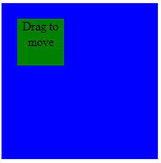
Moving an Element by Mouse
Develop a demo JavaScript program to show how to move an element by dragging the mouse pointer (demo).
The child (green) element can be moved by dragging the mouse pointer.
Dragging the mouse pointer involves the following sequence of events:
one mousedown event
one or more mousemove events
one mouseup event or mouseout event

Slide 3
Program Outline
Mouse event handlers are registered to the parent (blue) element which contains the child (green) element. The mouse event handlers do the following work:
Record the x and y coordinates (startx, starty) when the user presses the mouse button (mousedown event) while the mouse pointer is inside the child element.
Upon mousemove event, updates the position of the child element by adding the displacement between the location of the mouse pointer and (startx, starty)
Upon mouseup event, update the coordinates of the child element and terminate the process.

Slide 4
HTML Code
<link type="text/css" rel="stylesheet" href="moveshape.css">
<div class="board" id="board">
<div class="shape" id="shape">Drag to move
</div>
</div>

Slide 5
CSS Code
.board {
background-color: blue;
position: relative;
width: 200px;
height: 200px;
text-align: center;
overflow: hidden;
}
.shape {
background-color: green;
position: absolute;
top: 20px;
left: 20px;
width: 60px;
height: 60px;
cursor: pointer;
}

Slide 6
Finding the Mouse Event Coordinates
When user presses the mouse button when the pointer is inside the child element. The x and y coordinates of the event relative to the board element can be determined by the following code:
function findCoordinates(event) {
// find the coordinates of the event relative to the
// board element
if (event.layerX || event.layerX == 0) { // Firefox
event._x = event.layerX;
event._y = event.layerY;
} else if (event.offsetX || event.offsetX == 0) {// Opera
event._x = event.offsetX;
event._y = event.offsetY;
}

Slide 7
Finding the Mouse Event Coordinates (cont)
For non-IE browser, (event._x, event._y) is the location relative to the child element. Hence, the actual location in the parent element can be found by adding the offsets of the child element:
var target = event.target || event.srcElement;
// for non-IE browser, the coordinates needed to be
// adjusted by the offset of the target
if (nonIEbrowser) {
if (target != board) {
event._x += target.offsetLeft;
event._y += target.offsetTop;
}
}
} // findCoodinates

Slide 8
Some bugs and design problems
When the mouse pointer moves fast enough, the mouse pointer may move out of the child element and generates a mouseout event. This ‘fault’ mouseout event terminates the moving of the child element.
Solution: put another div element (glassPane) on top and gets the events on the glassPane
The code of the controller is mixed up with the event handling code of UI elements.
Solution: separate the code of the controller to form a Control class and add an adapter to bridge the difference between the interfaces.

Slide 9
A Simple HTML Screen Painter
Develop a simple html screen painter which can create HTML elements and move elements on screen (demo).
Use case: create element
User presses mouse button in the board. System shows the glass pane and creates the element at the position of the mouse event.
User moves the mouse in the glass pane. System resizes the element being created.
User releases the mouse button. System hides the glass pane.

Slide 10
Requirements (cont)
Use case: move element
User presses mouse button in the child element. System shows the glass pane.
User moves the mouse in the glass pane. System changes the element’s position.
User releases the mouse button. System hides the glass pane.

Slide 11
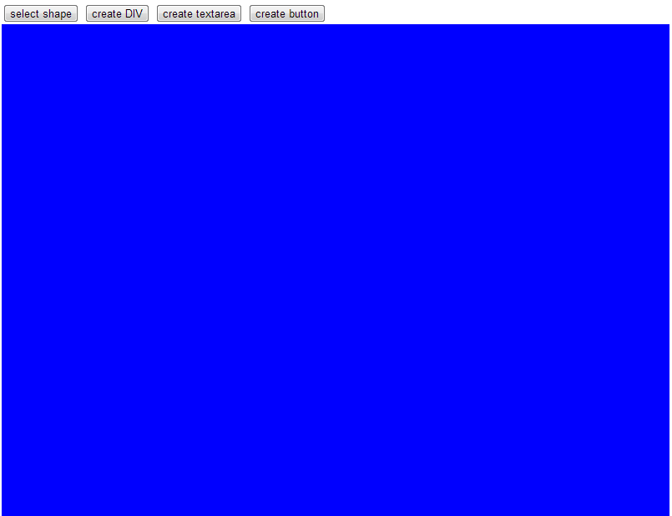
Screen Design

Slide 12
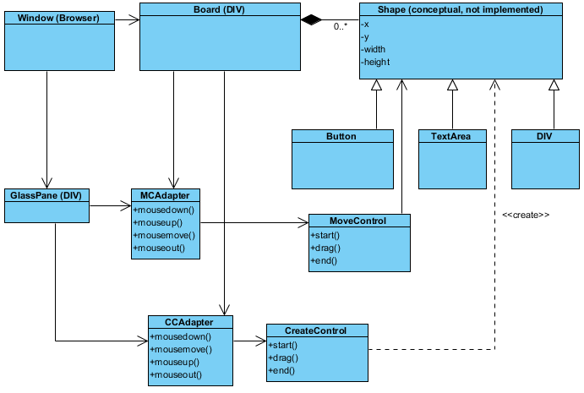
Class Design

Slide 13
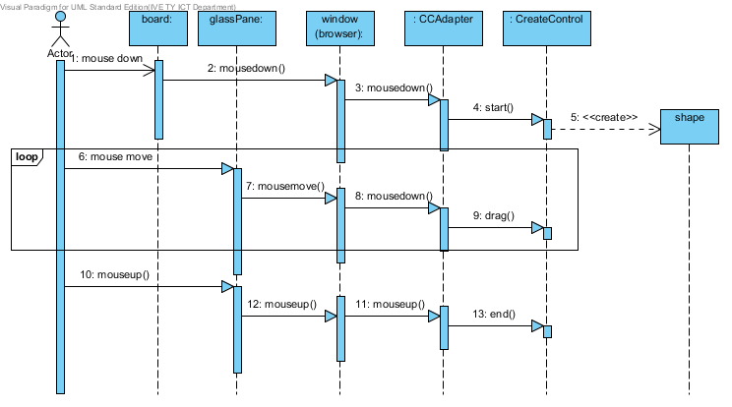
Sequence Diagram (Create Element)

Slide 14
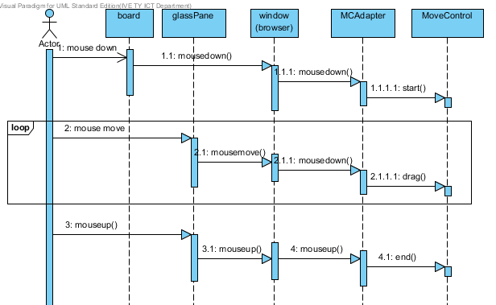
Sequence Diagram (Move Element)

Slide 15
Design Issues
The view and model for elements are mixed together. Attributes (e.g. x, y, width, height …) of model for element are directly attached to the view.
Need to define separate classes for the attributes of the model.

